Slide 1
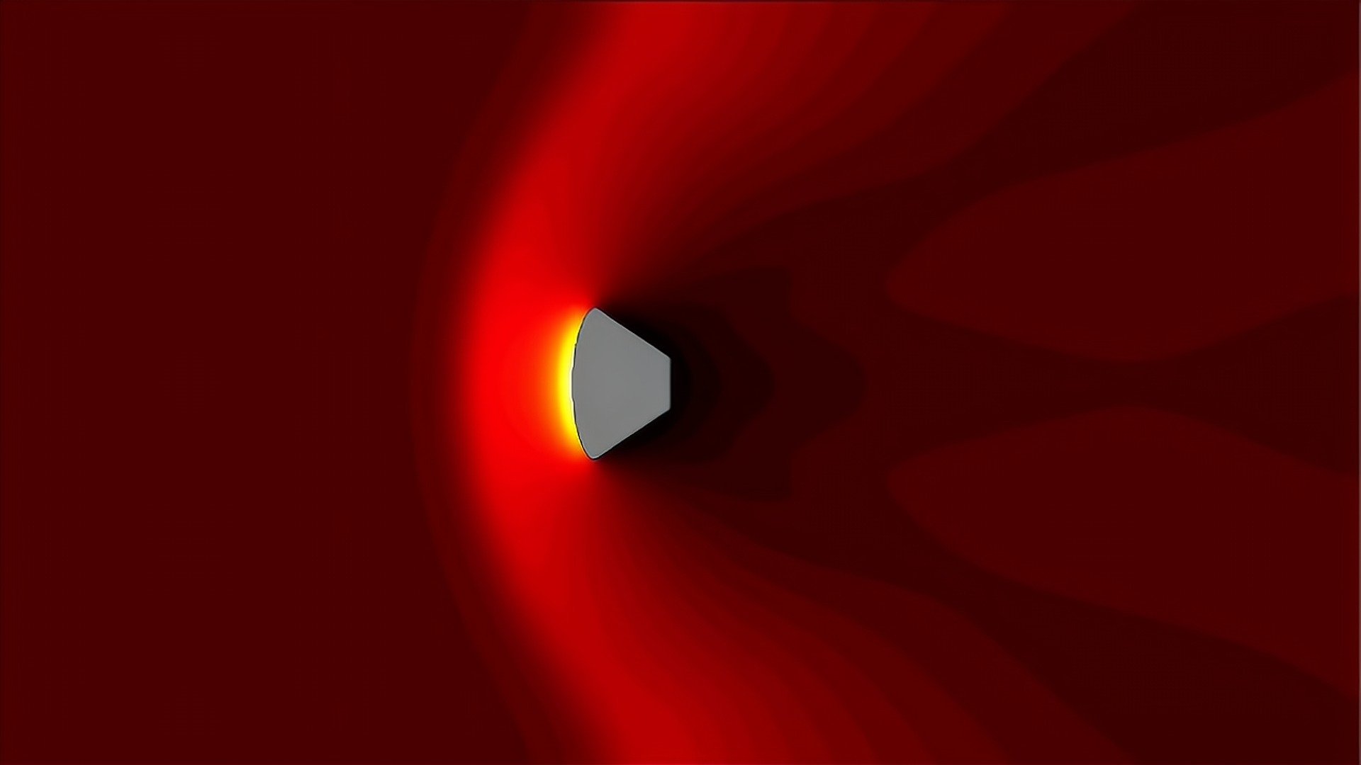
Applying Finite Volume Method to Solve the 2D Compressible Inviscid Navier-Stokes Equations
MA448 Final Project Part II
Spring 2022 - Khanal
By: Zach Eckley

Slide 2
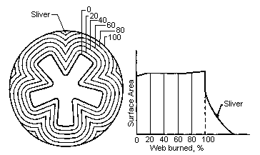
Motivation
Began as a method to solve internal ballistics for solid rocket motors
Began with a simpler FVM application
Hit snags with adaptive mesh
Port shape changes over time
Had trouble keeping same mesh connections
Didn’t find a working method until the start of the fall semester
Got FVM to work for water and then for air
Haven’t touched the project much since then

Slide 3
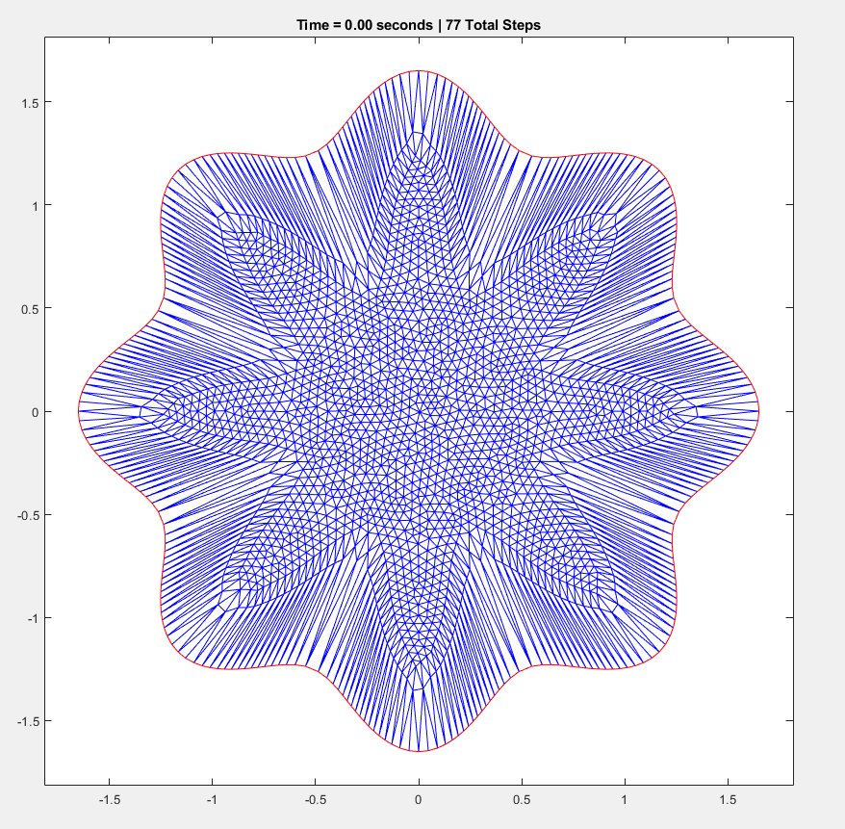
Motivation
Began as a method to solve internal ballistics for solid rocket motors
Began with a simpler FVM application
Hit snags with adaptive mesh
Port shape changes over time
Had trouble keeping same mesh connections
Didn’t find a working method until the start of the fall semester
Got FVM to work for water and then for air
Haven’t touched the project much since then

Slide 4
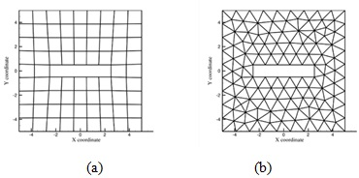
Topics
Mesh creation
Unstructured Mesh
Utilized PDE toolbox in Matlab
Variable cell density

Slide 5
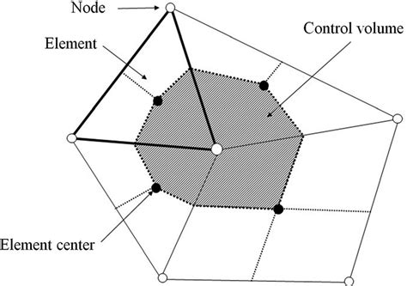
Topics
Mesh creation
Finite Volume Method

Slide 6
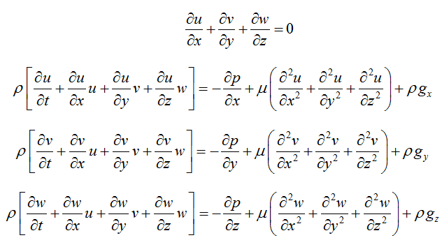
Topics
Mesh creation
Finite Volume Method
Setting up the equations
First order Finite Volume Method
Navier-Stokes
Compressible
Inviscid

Slide 7
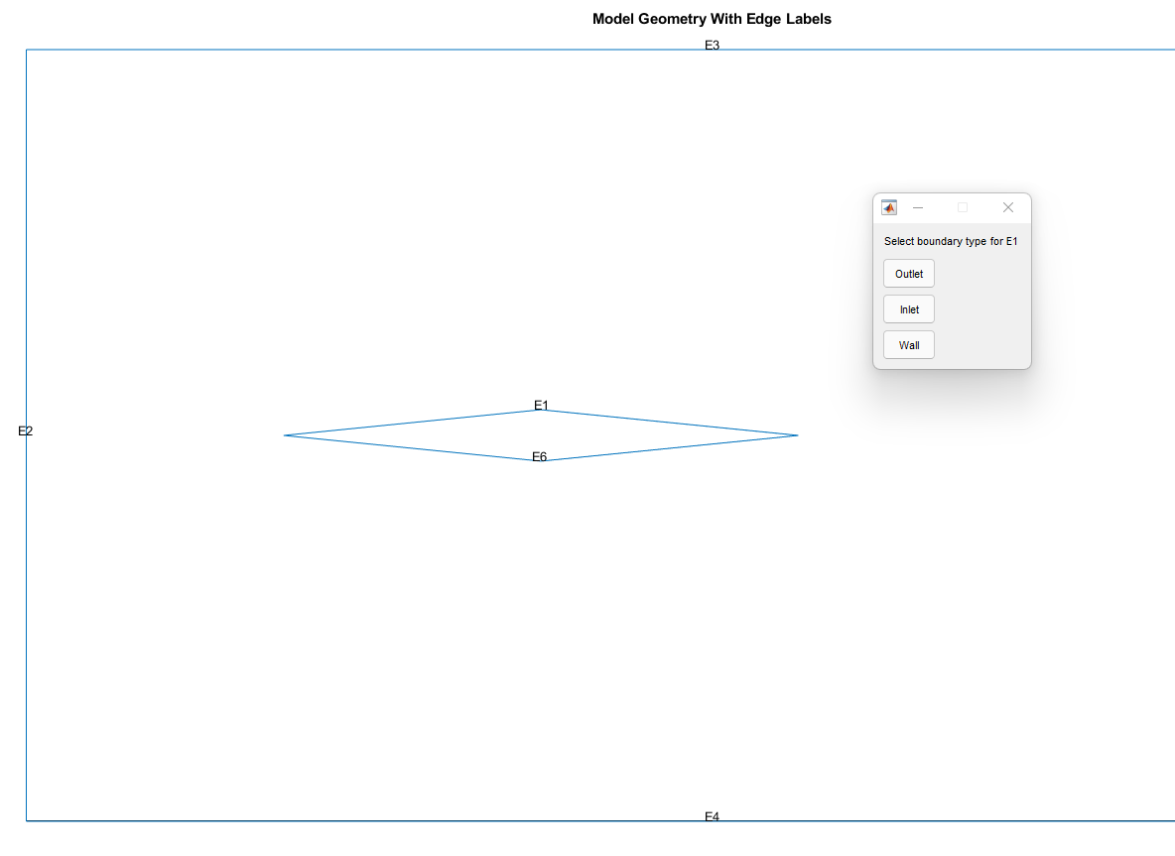
Topics
Mesh creation
Finite Volume Method
Setting up the equations
Applying boundary conditions
Dirichlet for inlet
Neumann for outlet
Neumann for wall

Slide 8
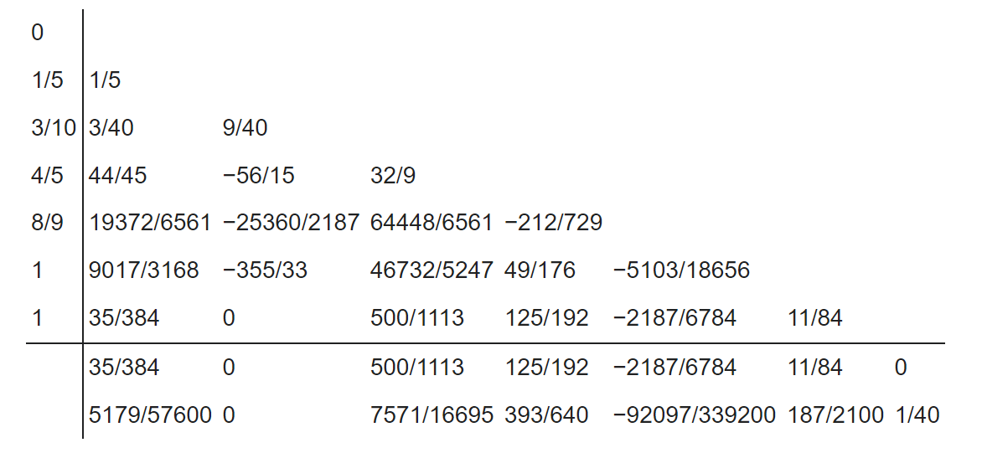
Topics
Mesh creation
Finite Volume Method
Setting up the equations
Applying boundary conditions
Solution method used
Equations set up in column vector
ODE45 solved the system
Chosen because it’s a MATLAB function and its adaptive

Slide 9
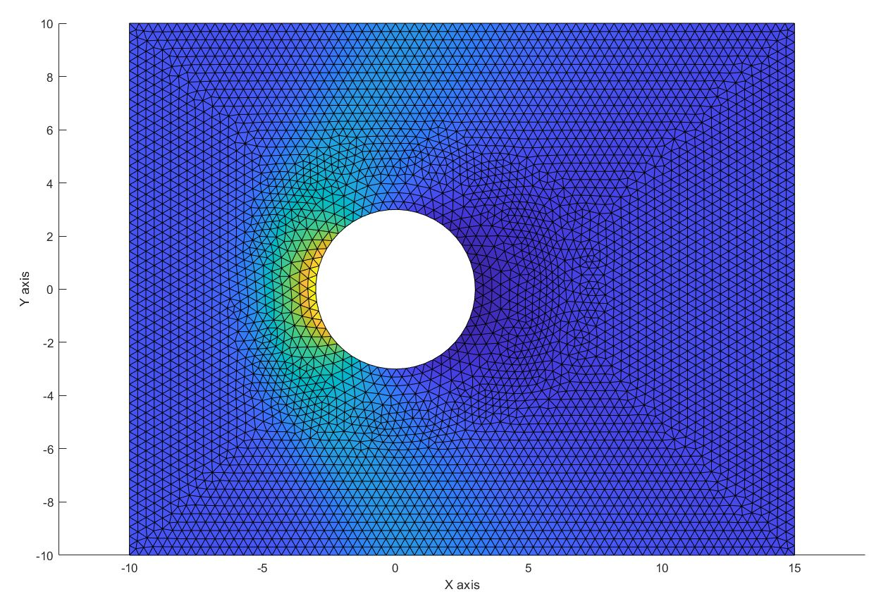
Topics
Mesh creation
Finite Volume Method
Setting up the equations
Applying boundary conditions
Solution method used
Displaying Results

Slide 10
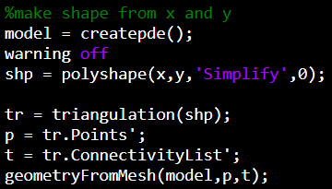
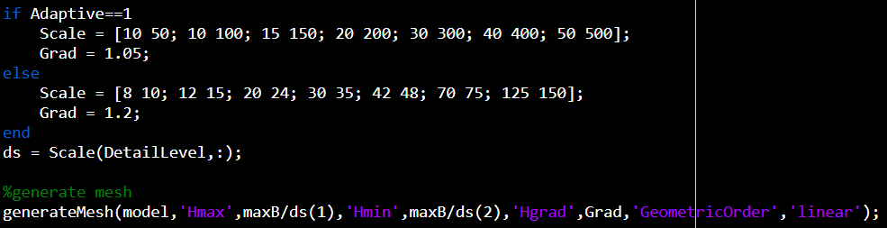
Delaunay Triangulation
Part 1
Creates pde model
Creates shape from x and y
Creates “pet” arrays
Uses p and t to make geometry
Part 2
Max and min cell size are chosen
Mesh is created based on cell size and geometry created previously

Slide 11
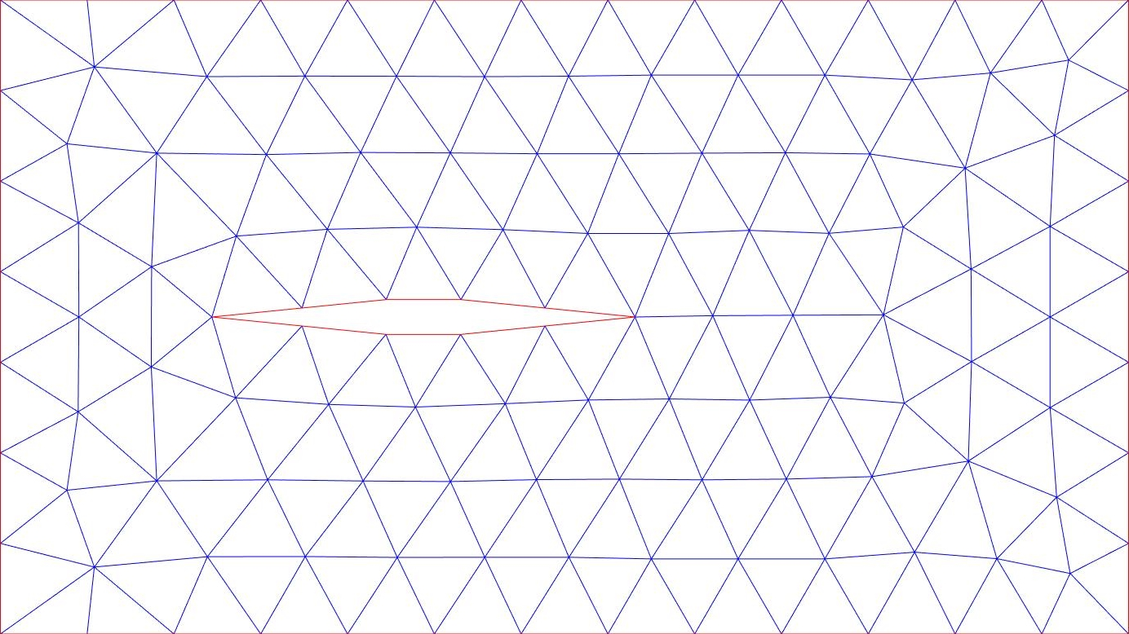

Slide 12
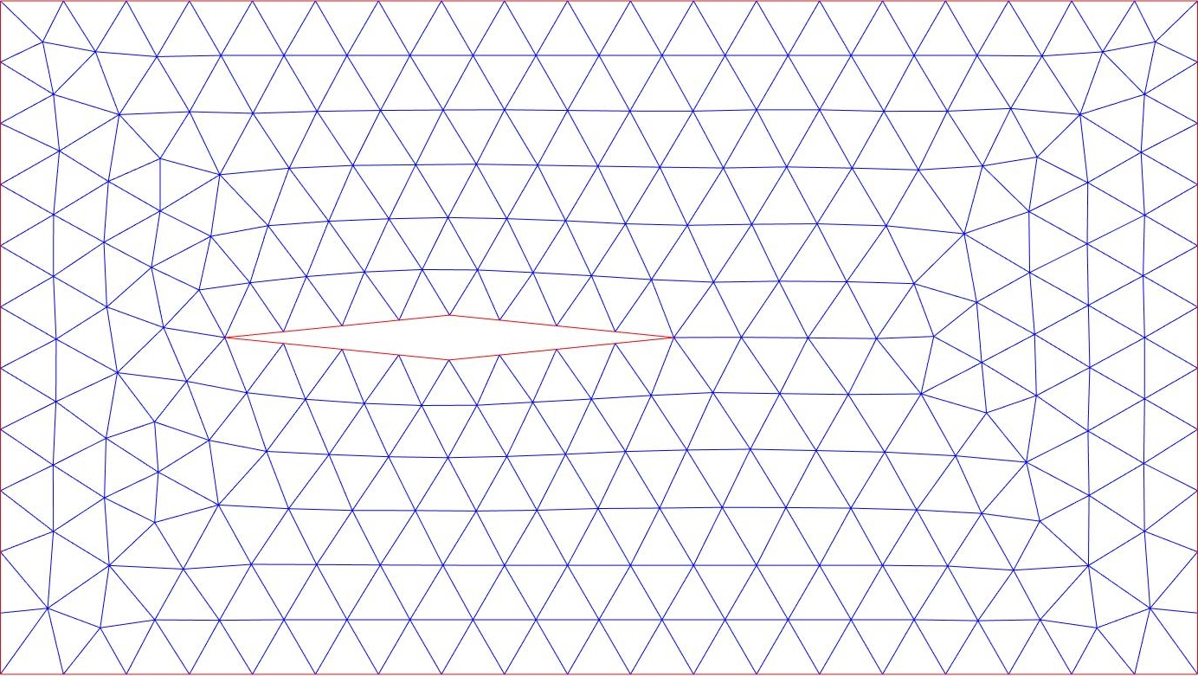

Slide 13
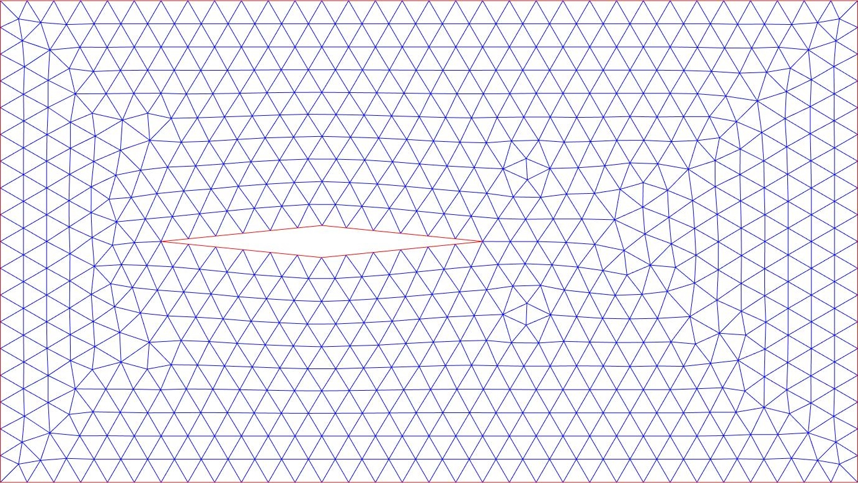

Slide 14
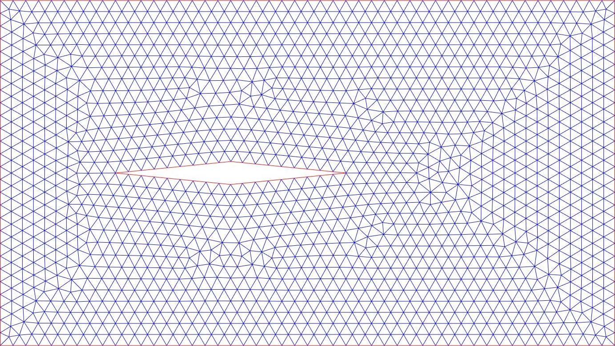

Slide 15
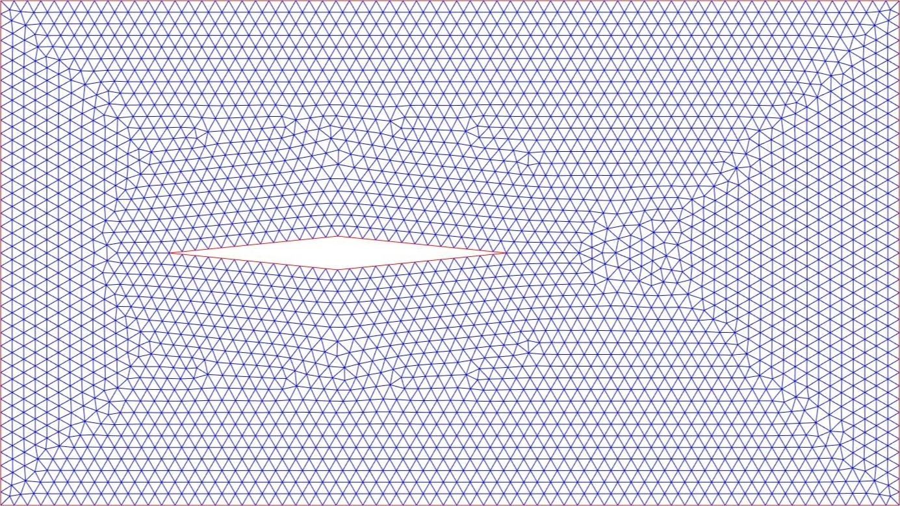

Slide 16
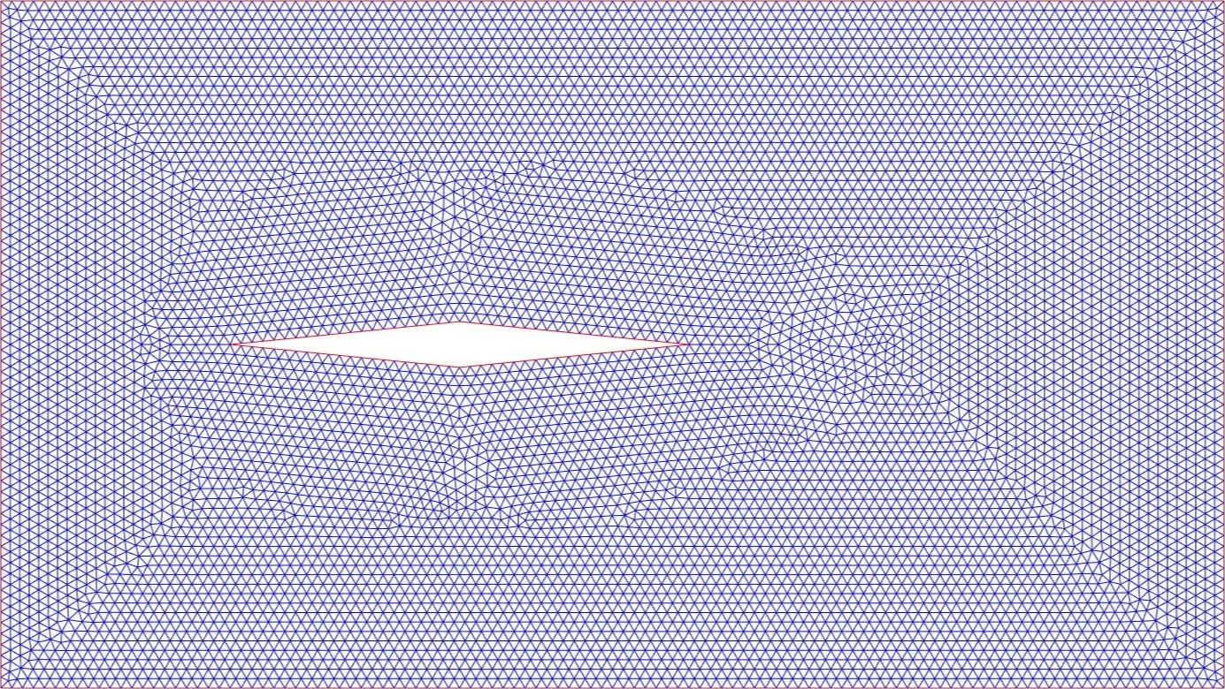

Slide 17
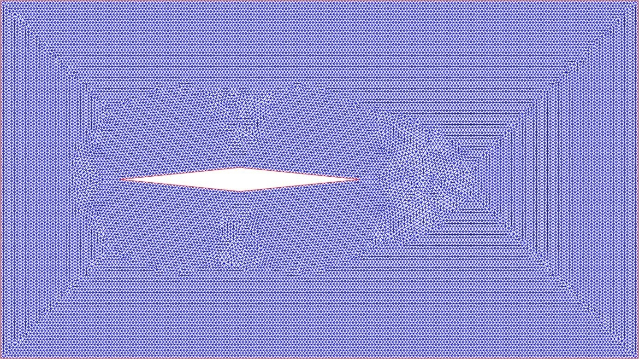

Slide 18
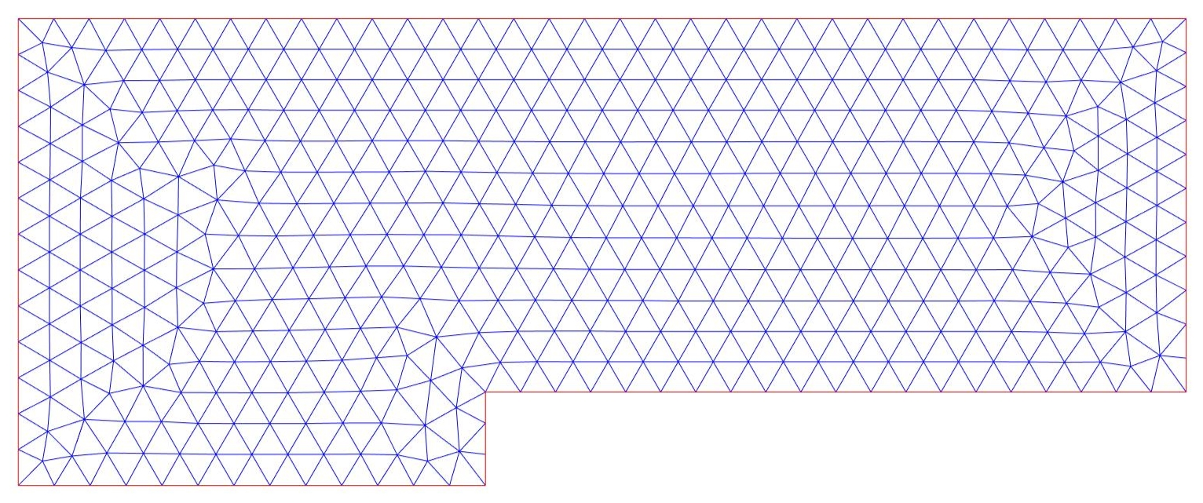
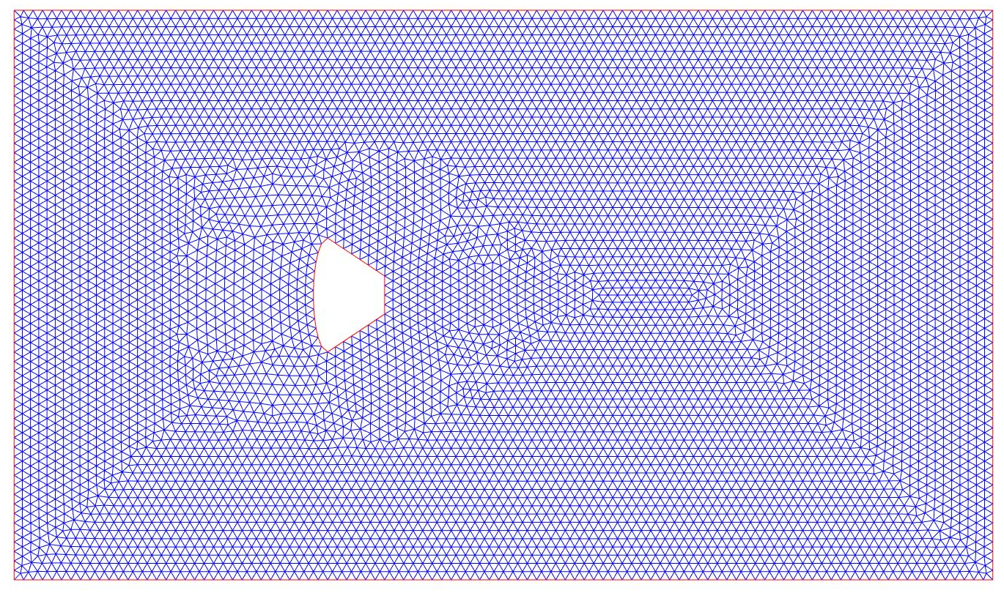
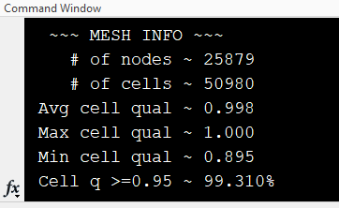
Mesh Information
Level | Node # | Cell # | Avg q | Max q | Min q | q≥0.95
1 | 129 | 208 | 0.982 | 1.000 | 0.793 | 90.685%
2 | 273 | 470 | 0.990 | 1.000 | 0.796 | 94.681%
3 | 709 | 1294 | 0.994 | 1.000 | 0.922 | 98.223%
4 | 1549 | 2912 | 0.995 | 1.000 | 0.894 | 97.218%
5 | 3019 | 5776 | 0.996 | 1.000 | 0.887 | 98.996%
6 | 8203 | 15972 | 0.997 | 1.000 | 0.912 | 99.192%
7 | 25879 | 50980 | 0.998 | 1.000 | 0.895 | 99.310%

Slide 19
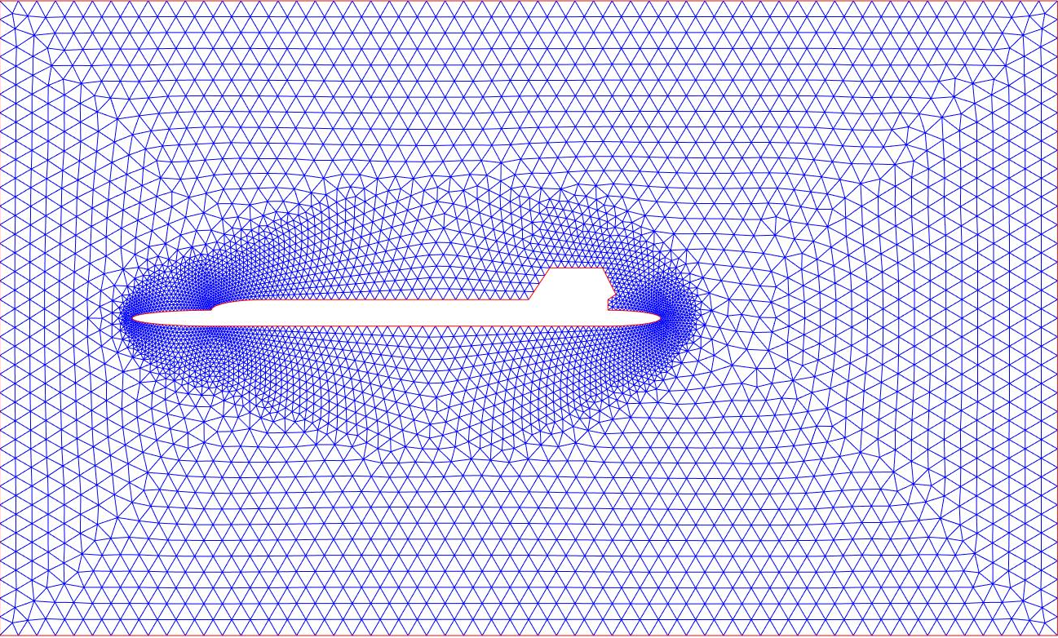
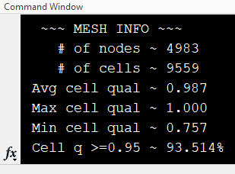

Slide 20
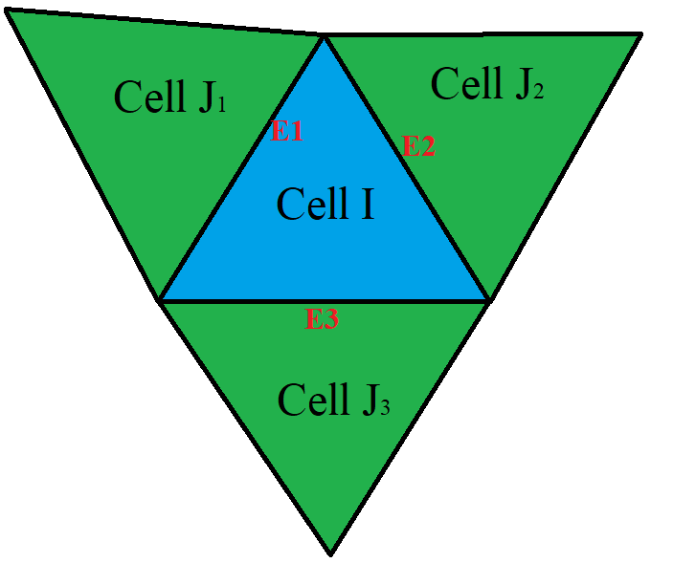
Delaunay Triangulation
P – points/nodes in the mesh. Lists x and y coordinates of each node [2xN]
E – Elements/cells in the mesh. Lists the three nodes that create it in terms of their index in P. [3xE]
T – Connectivity list. Includes which nodes are connected to create a cell

Slide 21

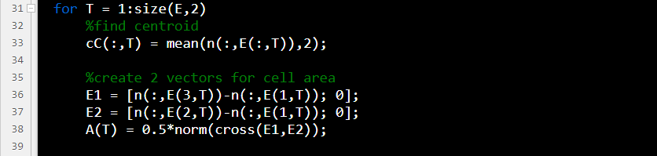

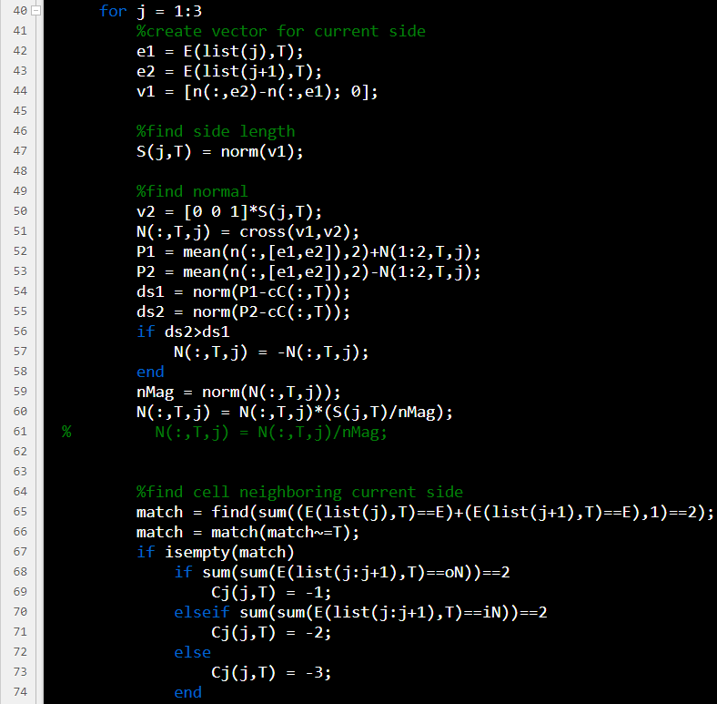
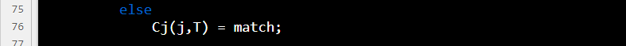
meshInfo function
Cell areas are found
Side lengths are found
Side normals are found
Find cell connectivity by finding cells that share 2 points

Slide 22
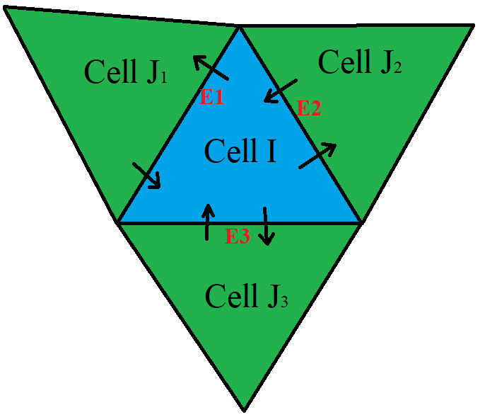

Finite Volume Method
Finite volume looks at the movement of properties throughout the cells rather than specific values.
2D cases require analysis of the flux in X and Y
3D cases require additional analysis of flux in Z
Over many times steps the flux in and out of the cell will balance to achieve steady state
Allows for the analysis of both structured and unstructured meshes
$$\frac{∂Q}{∂t}=\frac{1}{A_{i}}\sum_{s=1}^{\# of sides}{\left(Flux_{in}−Flux_{out}\right)L_{side}}$$

Slide 23


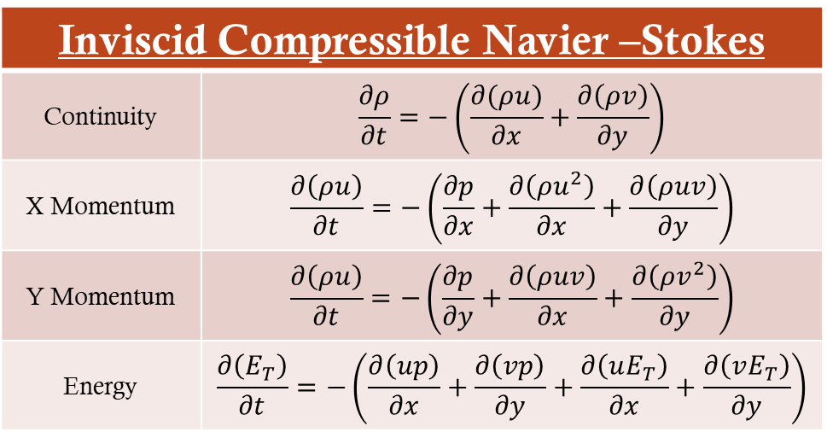
Equations
Finite Volume Scheme
Inviscid Compressible Navier –Stokes
Continuity | $$\frac{∂ρ}{∂t}=−\left(\frac{∂(ρu)}{∂x}+\frac{∂\left(ρv\right)}{∂y}\right)$$
X Momentum | $$\frac{∂\left(ρu\right)}{∂t}=−\left(\frac{∂p}{∂x}+\frac{∂\left(ρu^{2}\right)}{∂x}+\frac{∂\left(ρuv\right)}{∂y}\right)$$
Y Momentum | $$\frac{∂\left(ρu\right)}{∂t}=−\left(\frac{∂p}{∂y}+\frac{∂\left(ρuv\right)}{∂x}+\frac{∂\left(ρv^{2}\right)}{∂y}\right)$$
Energy | $$\frac{∂\left(E_{T}\right)}{∂t}=−\left(\frac{∂\left(up\right)}{∂x}+\frac{∂\left(vp\right)}{∂y}+\frac{∂\left(uE_{T}\right)}{∂x}+\frac{∂\left(vE_{T}\right)}{∂y}\right)$$
$$F=\left\{\begin{aligned}\begin{matrix}ρu \\ ρu^{2}+P\end{matrix} \\ \begin{matrix}ρuv \\ ρuh\end{matrix}\end{aligned}\right.$$
$$G=\left\{\begin{aligned}\begin{matrix}ρv \\ ρuv\end{matrix} \\ \begin{matrix}ρv^{2}+P \\ ρvh\end{matrix}\end{aligned}\right.$$
Mass flux in x dir.
X momentum flux in x dir.
Y momentum flux in x dir.
Energy flux in x dir.
Mass flux in y dir.
X momentum flux in y dir.
Y momentum flux in y dir.
Energy flux in y dir.
$$\frac{∂W}{∂t}=\frac{1}{C_{i}}\sum_{j∈N_{i}}{S_{ij}\left(\frac{∂F}{∂x}n_{x}+\frac{∂G}{∂y}n_{y}\right)}$$
$$\frac{∂F}{∂x}={\left[\begin{matrix}\begin{matrix}\frac{∂(ρu)}{∂x}, & \frac{∂\left(ρu^{2}+P\right)}{∂x},\end{matrix} & \begin{matrix}\frac{∂\left(ρuv\right)}{∂x}, & \frac{∂\left(ρuh\right)}{∂x}\end{matrix}\end{matrix}\right]}^{T}$$
$$\frac{∂G}{∂y}={\left[\begin{matrix}\begin{matrix}\frac{∂\left(ρv\right)}{∂y}, & \frac{∂\left(ρuv\right)}{∂y},\end{matrix} & \begin{matrix}\frac{∂\left(ρv^{2}+P\right)}{∂y}, & \frac{∂\left(ρvh\right)}{∂y}\end{matrix}\end{matrix}\right]}^{T}$$
Cj
Ci

Slide 24





Fx out
Fx in
$$\left[\begin{matrix}\begin{matrix}{\left(ρu\right)}_{1,s1} \\ {\left(ρu\right)}_{2,s1} \\ {\left(ρu\right)}_{3,s1}\end{matrix} & \begin{matrix}\begin{matrix}{\left(ρu^{2}+P\right)}_{1,s1} \\ {\left({ρu}^{2}+P\right)}_{2,s1} \\ {\left({ρu}^{2}+P\right)}_{3,s1}\end{matrix} & \begin{matrix}{\left(ρuv\right)}_{1,s1} \\ {\left(ρuv\right)}_{2,s1} \\ {\left(ρuv\right)}_{3,s1}\end{matrix}\end{matrix} & \begin{matrix}{\left(ρuh\right)}_{1,s1} \\ {\left(ρuh\right)}_{2,s1} \\ {\left(ρuh\right)}_{3,s1}\end{matrix} \\ ⋮ & \begin{matrix} ⋮ & ⋮\end{matrix} & ⋮ \\ \begin{matrix}{\left(ρu\right)}_{N−2,s1} \\ {\left(ρu\right)}_{N−1,s1} \\ {\left(ρu\right)}_{N,s1}\end{matrix} & \begin{matrix}\begin{matrix}{\left({ρu}^{2}+P\right)}_{N−2,s1} \\ {\left({ρu}^{2}+P\right)}_{N−1,s1} \\ {\left({ρu}^{2}+P\right)}_{N,s1}\end{matrix} & \begin{matrix}{\left(ρuv\right)}_{N−2,s1} \\ {\left(ρuv\right)}_{N−1,s1} \\ {\left(ρuv\right)}_{N,s1}\end{matrix}\end{matrix} & \begin{matrix}{\left(ρuh\right)}_{N−2,s1} \\ {\left(ρuh\right)}_{N−1,s1} \\ {\left(ρuh\right)}_{N,s1}\end{matrix}\end{matrix}\right]$$
$$\left[\begin{matrix}\begin{matrix}{\left(ρu\right)}_{j1,s1} \\ {\left(ρu\right)}_{j2,s1} \\ {\left(ρu\right)}_{j3,s1}\end{matrix} & \begin{matrix}\begin{matrix}{\left(ρu^{2}+P\right)}_{j1,s1} \\ {\left({ρu}^{2}+P\right)}_{j2,s1} \\ {\left({ρu}^{2}+P\right)}_{j3,s1}\end{matrix} & \begin{matrix}{\left(ρuv\right)}_{j1,s1} \\ {\left(ρuv\right)}_{j2,s1} \\ {\left(ρuv\right)}_{j3,s1}\end{matrix}\end{matrix} & \begin{matrix}{\left(ρuh\right)}_{j1,s1} \\ {\left(ρuh\right)}_{j2,s1} \\ {\left(ρuh\right)}_{j3,s1}\end{matrix} \\ ⋮ & \begin{matrix} ⋮ & ⋮\end{matrix} & ⋮ \\ \begin{matrix}{\left(ρu\right)}_{jN−2,s1} \\ {\left(ρu\right)}_{jN−1,s1} \\ {\left(ρu\right)}_{jN,s1}\end{matrix} & \begin{matrix}\begin{matrix}{\left({ρu}^{2}+P\right)}_{jN−2,s1} \\ {\left({ρu}^{2}+P\right)}_{jN−1,s1} \\ {\left({ρu}^{2}+P\right)}_{jN,s1}\end{matrix} & \begin{matrix}{\left(ρuv\right)}_{jN−2,s1} \\ {\left(ρuv\right)}_{jN−1,s1} \\ {\left(ρuv\right)}_{jN,s1}\end{matrix}\end{matrix} & \begin{matrix}{\left(ρuh\right)}_{jN−2,s1} \\ {\left(ρuh\right)}_{jN−1,s1} \\ {\left(ρuh\right)}_{jN,s1}\end{matrix}\end{matrix}\right]$$
Fy out
Fy in
$$\left[\begin{matrix}\begin{matrix}{\left(ρv\right)}_{1,s1} \\ {\left(ρv\right)}_{2,s1} \\ {\left(ρv\right)}_{3,s1}\end{matrix} & \begin{matrix}\begin{matrix}{\left(ρuv\right)}_{1,s1} \\ {\left(ρuv\right)}_{2,s1} \\ {\left(ρuv\right)}_{3,s1}\end{matrix} & \begin{matrix}{\left(ρv^{2}+P\right)}_{1,s1} \\ {\left(ρv^{2}+P\right)}_{2,s1} \\ {\left(ρv^{2}+P\right)}_{3,s1}\end{matrix}\end{matrix} & \begin{matrix}{\left(ρvh\right)}_{1,s1} \\ {\left(ρvh\right)}_{2,s1} \\ {\left(ρvh\right)}_{3,s1}\end{matrix} \\ ⋮ & \begin{matrix} ⋮ & ⋮\end{matrix} & ⋮ \\ \begin{matrix}{\left(ρv\right)}_{N−2,s1} \\ {\left(ρv\right)}_{N−1,s1} \\ {\left(ρv\right)}_{N,s1}\end{matrix} & \begin{matrix}\begin{matrix}{\left(ρuv\right)}_{N−2,s1} \\ {\left(ρuv\right)}_{N−1,s1} \\ {\left(ρuv\right)}_{N,s1}\end{matrix} & \begin{matrix}{\left(ρv^{2}+P\right)}_{N−2,s1} \\ {\left(ρv^{2}+P\right)}_{N−1,s1} \\ {\left(ρv^{2}+P\right)}_{N,s1}\end{matrix}\end{matrix} & \begin{matrix}{\left(ρvh\right)}_{N−2,s1} \\ {\left(ρvh\right)}_{N−1,s1} \\ {\left(ρvh\right)}_{N,s1}\end{matrix}\end{matrix}\right]$$
$$\left[\begin{matrix}\begin{matrix}{\left(ρv\right)}_{j1,s1} \\ {\left(ρv\right)}_{j2,s1} \\ {\left(ρv\right)}_{j3,s1}\end{matrix} & \begin{matrix}\begin{matrix}{\left(ρuv\right)}_{j1,s1} \\ {\left(ρuv\right)}_{j2,s1} \\ {\left(ρuv\right)}_{j3,s1}\end{matrix} & \begin{matrix}{\left(ρv^{2}+P\right)}_{j1,s1} \\ {\left(ρv^{2}+P\right)}_{j2,s1} \\ {\left(ρv^{2}+P\right)}_{j3,s1}\end{matrix}\end{matrix} & \begin{matrix}{\left(ρvh\right)}_{j1,s1} \\ {\left(ρvh\right)}_{j2,s1} \\ {\left(ρvh\right)}_{j3,s1}\end{matrix} \\ ⋮ & \begin{matrix} ⋮ & ⋮\end{matrix} & ⋮ \\ \begin{matrix}{\left(ρv\right)}_{jN−2,s1} \\ {\left(ρv\right)}_{jN−1,s1} \\ {\left(ρv\right)}_{jN,s1}\end{matrix} & \begin{matrix}\begin{matrix}{\left(ρuv\right)}_{jN−2,s1} \\ {\left(ρuv\right)}_{jN−1,s1} \\ {\left(ρuv\right)}_{jN,s1}\end{matrix} & \begin{matrix}{\left(ρv^{2}+P\right)}_{jN−2,s1} \\ {\left(ρv^{2}+P\right)}_{jN−1,s1} \\ {\left(ρv^{2}+P\right)}_{jN,s1}\end{matrix}\end{matrix} & \begin{matrix}{\left(ρvh\right)}_{jN−2,s1} \\ {\left(ρvh\right)}_{jN−1,s1} \\ {\left(ρvh\right)}_{jN,s1}\end{matrix}\end{matrix}\right]$$
$F_{out}=F_{x_{i}}n_{x}+F_{y_{i}}n_{y}$ $F_{in}=F_{x_{j}}n_{x}+F_{y_{j}}n_{y}$
$$F_{i}=\left(F_{out}+F_{in}\right)/2$$

Slide 25
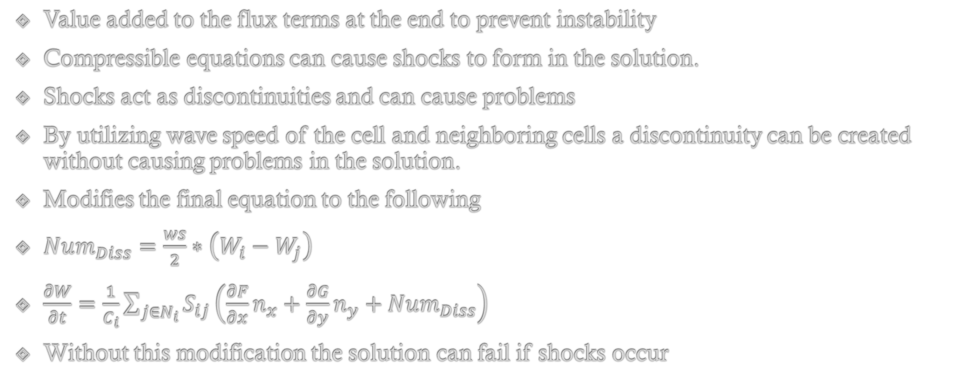
Numerical Dissipation
Value added to the flux terms at the end to prevent instability
Compressible equations can cause shocks to form in the solution.
Shocks act as discontinuities and can cause problems
By utilizing wave speed of the cell and neighboring cells a discontinuity can be created without causing problems in the solution.
Modifies the final equation to the following
$Num_{Diss}=\frac{ws}{2}∗\left(W_{i}−W_{j}\right)$
$\frac{∂W}{∂t}=\frac{1}{C_{i}}\sum_{j∈N_{i}}{S_{ij}\left(\frac{∂F}{∂x}n_{x}+\frac{∂G}{∂y}n_{y}+Num_{Diss}\right)}$
Without this modification the solution can fail if shocks occur

Slide 26
Boundary Conditions
Outlets
Inlets
Walls
Labeled as -1
“Ghost node” approach
Imaginary cell is “created” on opposite side.
Allows steady flux out of the cell based on the conditions of cell at that time.
Neumann condition at outlets allowing free flow of quantities
Labeled as -2
Flux is defined before solution begins
Flux is equal to whatever the user set it to
Dirichlet condition at inlet sides with user defined flux values.
Labeled as -3
Flux outwards is 0 because the wall prevents flux
With heat transfer energy flux could be possible
Mass flux should remain 0 unless ablation occurs at high speeds
Neumann condition at wall sides with first derivative equal to 0

Slide 27



Setting up RK4 (ode45)
$$F_{i}=\left(F_{out}+F_{in}\right)/2≈\frac{∂W}{∂T}$$
$$dwdt= \begin{matrix}\begin{matrix}\begin{matrix}\begin{matrix}ρ_{t_{c1}} \\ ρu_{t_{c1}}\end{matrix} \\ \begin{matrix}ρv_{t_{c1}} \\ ρh_{t_{c1}}\end{matrix}\end{matrix} \\ \begin{matrix}\begin{matrix}ρ_{t_{c2}} \\ ρu_{t_{c2}}\end{matrix} \\ \begin{matrix}ρv_{t_{c2}} \\ ρh_{t_{c2}}\end{matrix}\end{matrix}\end{matrix} \\ ⋮ \\ \begin{matrix}\begin{matrix}\begin{matrix}ρ_{t_{cN−1}} \\ ρu_{t_{cN}−1}\end{matrix} \\ \begin{matrix}ρv_{t_{cN}−1} \\ ρh_{t_{cN−1}}\end{matrix}\end{matrix} \\ \begin{matrix}\begin{matrix}ρ_{t_{cN}} \\ ρu_{t_{cN}}\end{matrix} \\ \begin{matrix}ρv_{t_{cN}} \\ ρh_{t_{cN}}\end{matrix}\end{matrix}\end{matrix}\end{matrix}$$
F_{i} is a matrix of the first order time derivatives of the conditions of the cell
ddtAir function uses the connectivity, the normals, and the areas of each cell to calculate the first order derivatives using the finite volume method.
Those first order derivatives are then set up in a column vector and solved in ode45
$$F_{i}≈\frac{∂W}{∂t}={\left[\begin{matrix}\begin{matrix}\frac{∂ρ}{∂t}, & \frac{∂\left(ρu\right)}{∂t},\end{matrix} & \begin{matrix}\frac{∂\left(ρv\right)}{∂t}, & \frac{∂\left(H\right)}{∂t}\end{matrix}\end{matrix}\right]}_{i}$$

Slide 28
Set up Mesh
Determine Boundaries
Collect Mesh info
Define and create IC
Organize Inputs
Combine Flux and Numerical dissipation
Calculate x flux
Calculate y flux
Organize flux into dwdt vector
Display/Update Results
Create array of neighboring flux for each cell
ode45 solves dwdt vector
Calculate wave speed
End of time span?
Yes
No

Slide 29
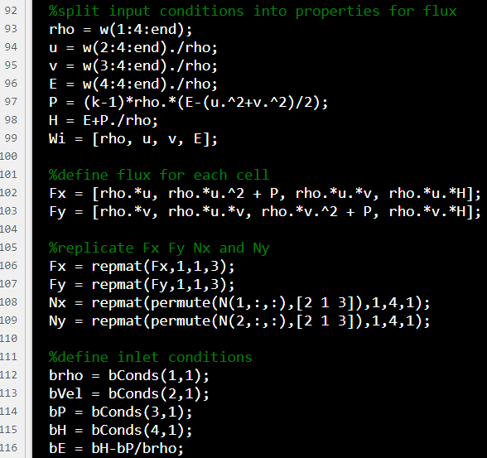
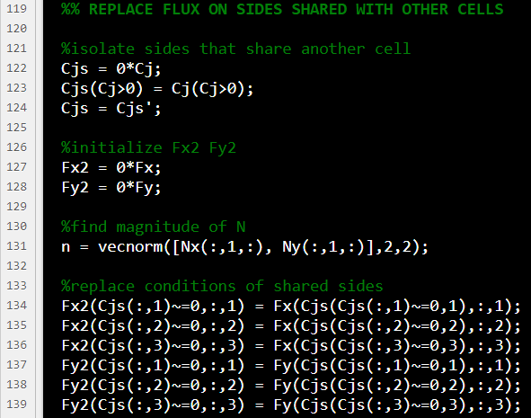

Slide 30
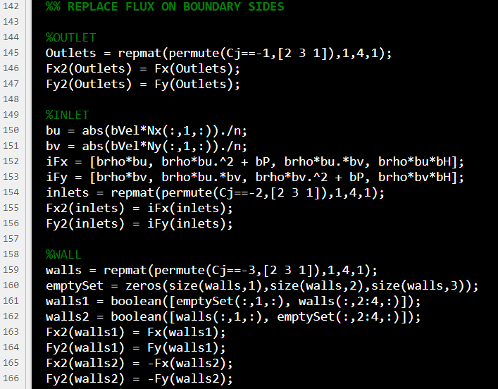

Slide 31
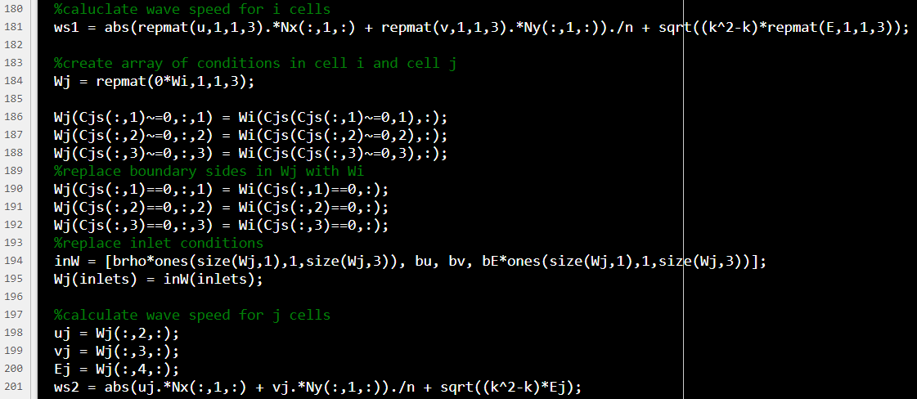
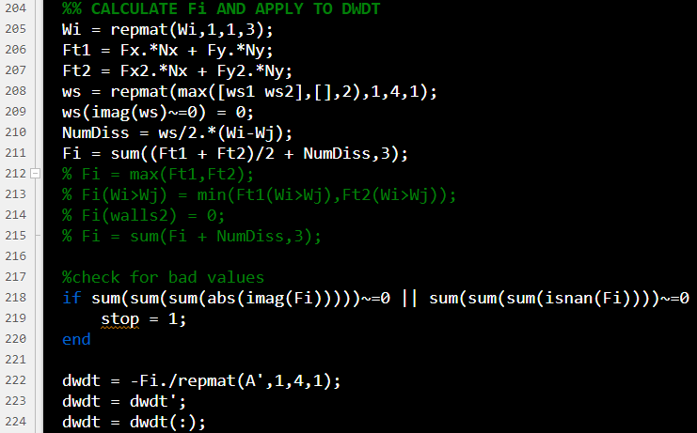

Slide 32
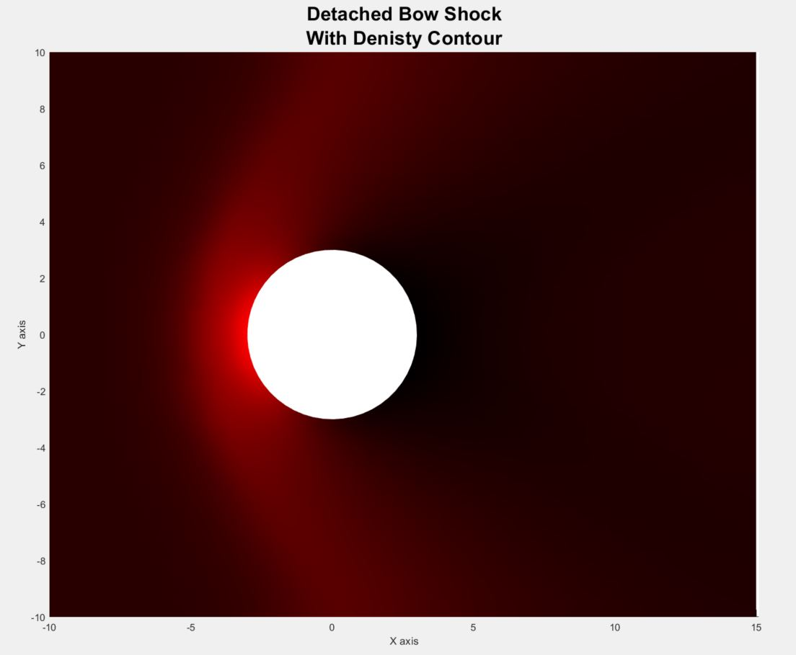

Slide 33

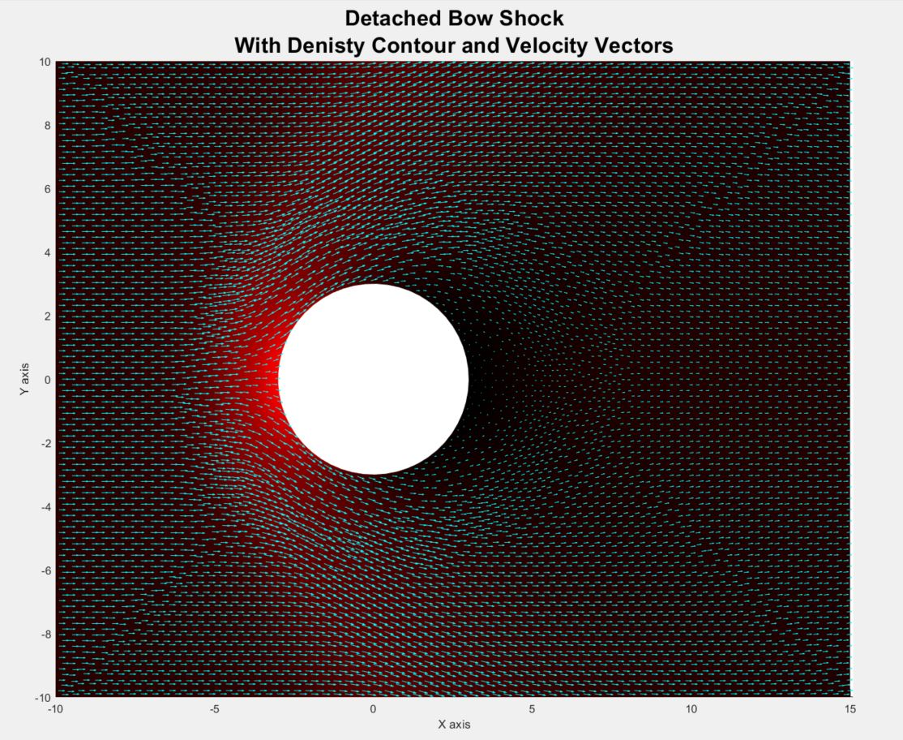
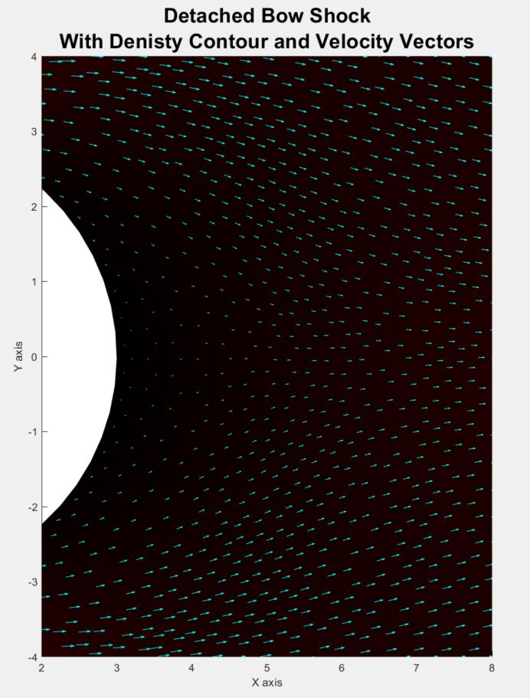

Slide 34
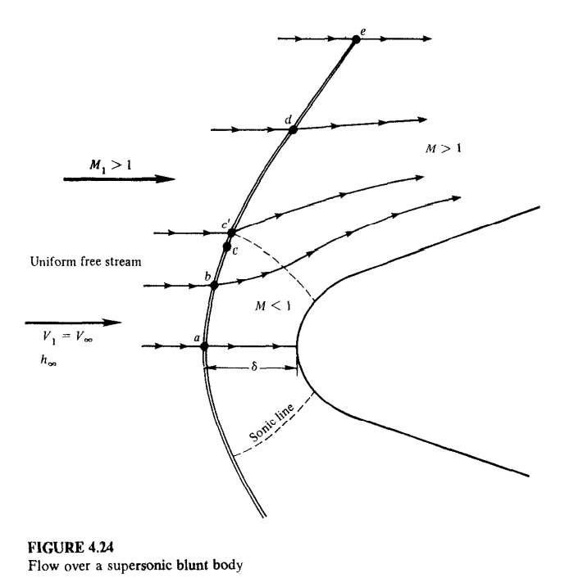

Slide 35
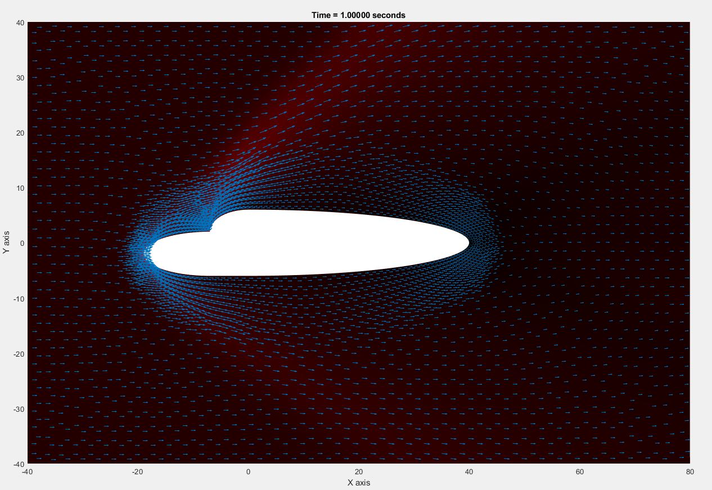

Slide 36
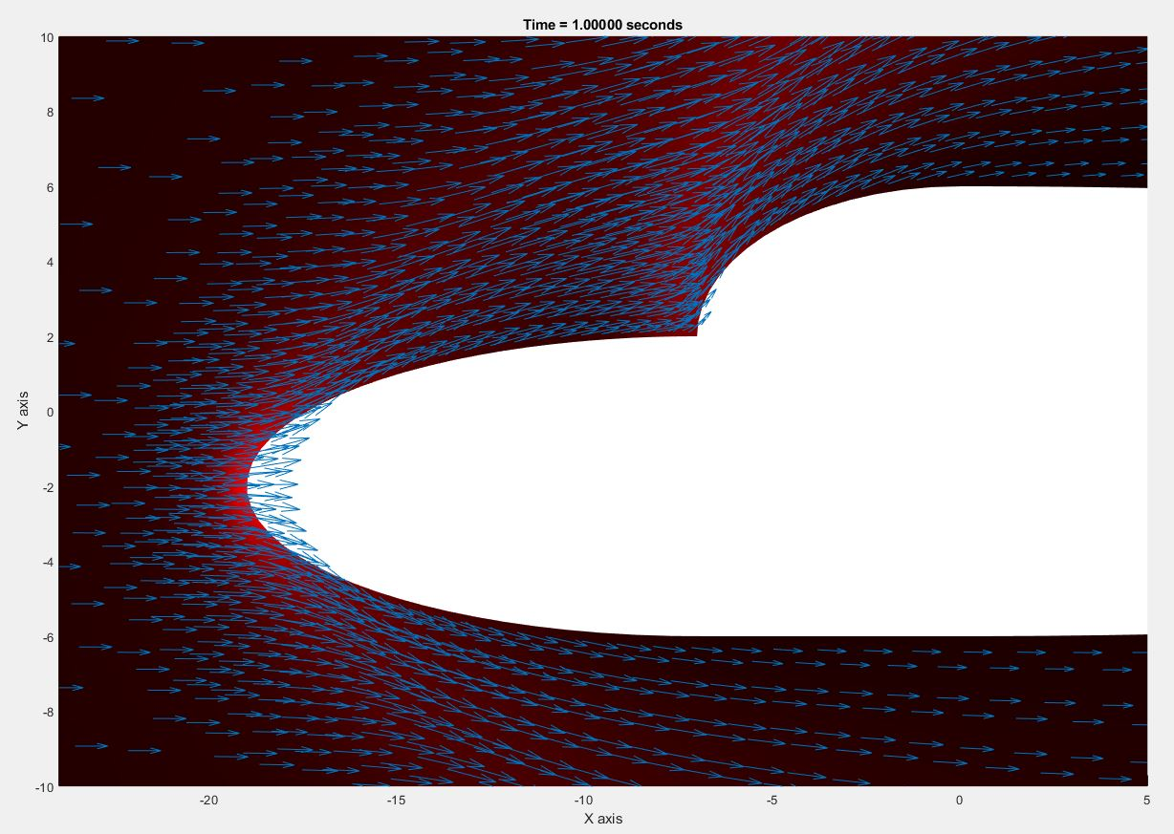

Slide 37
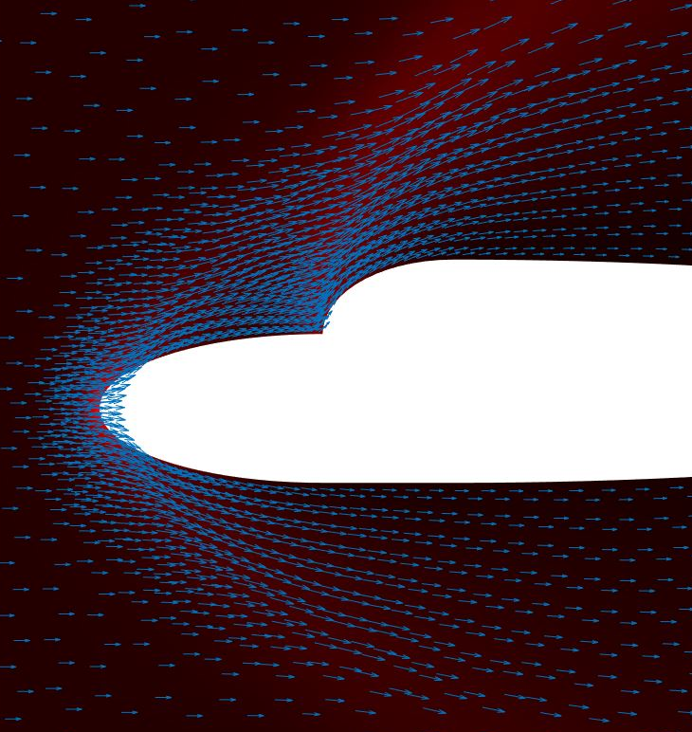
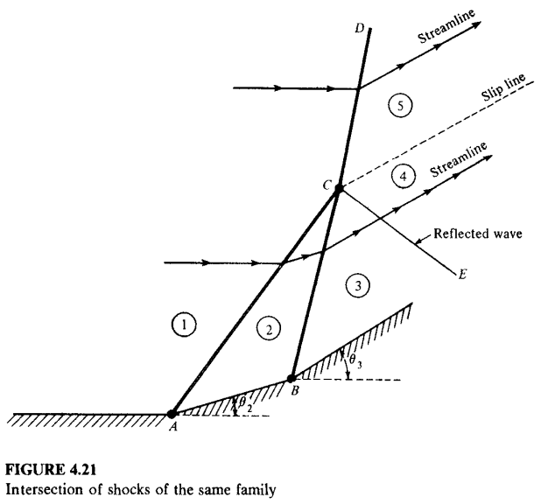

Slide 38
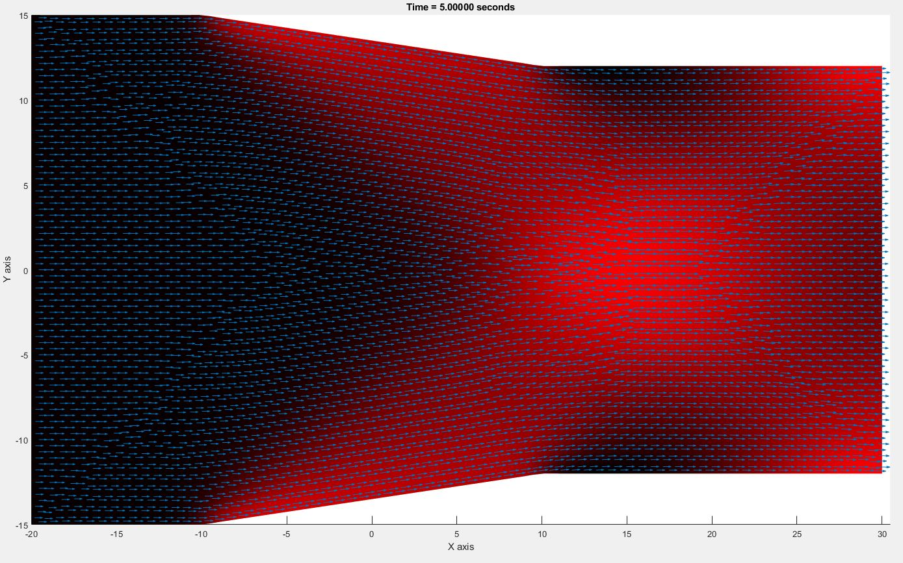

Slide 40
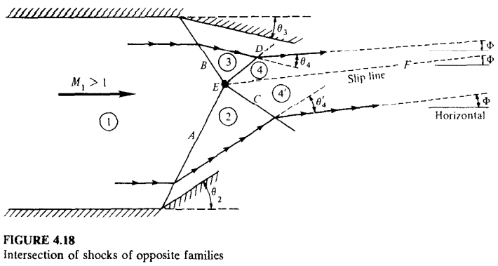

Slide 42
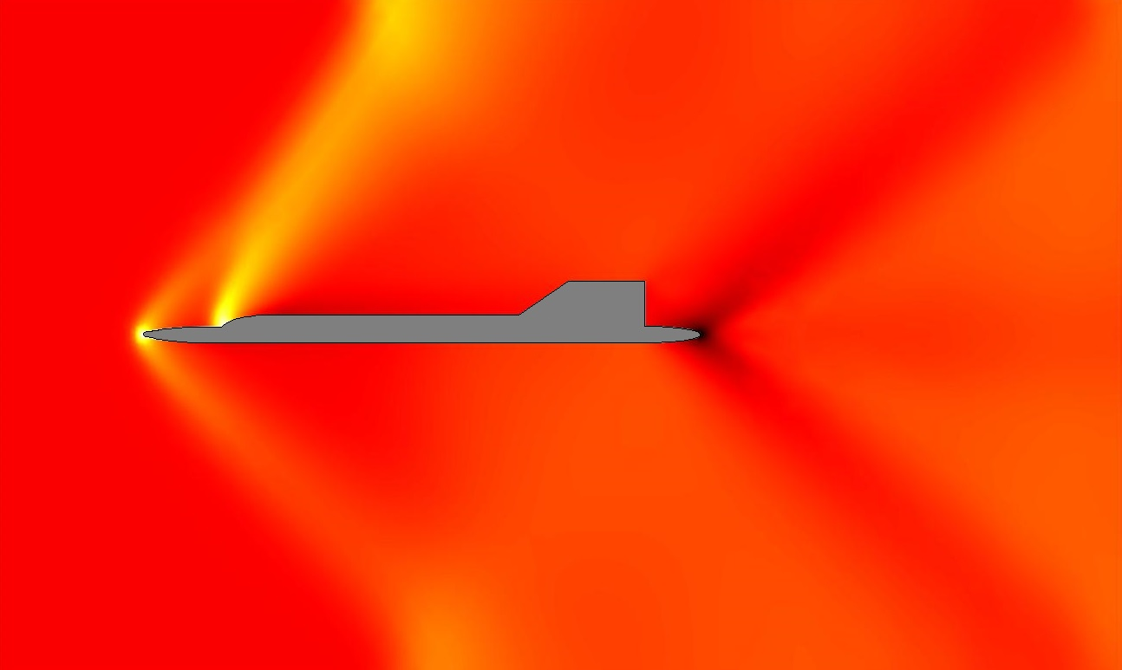

Slide 43
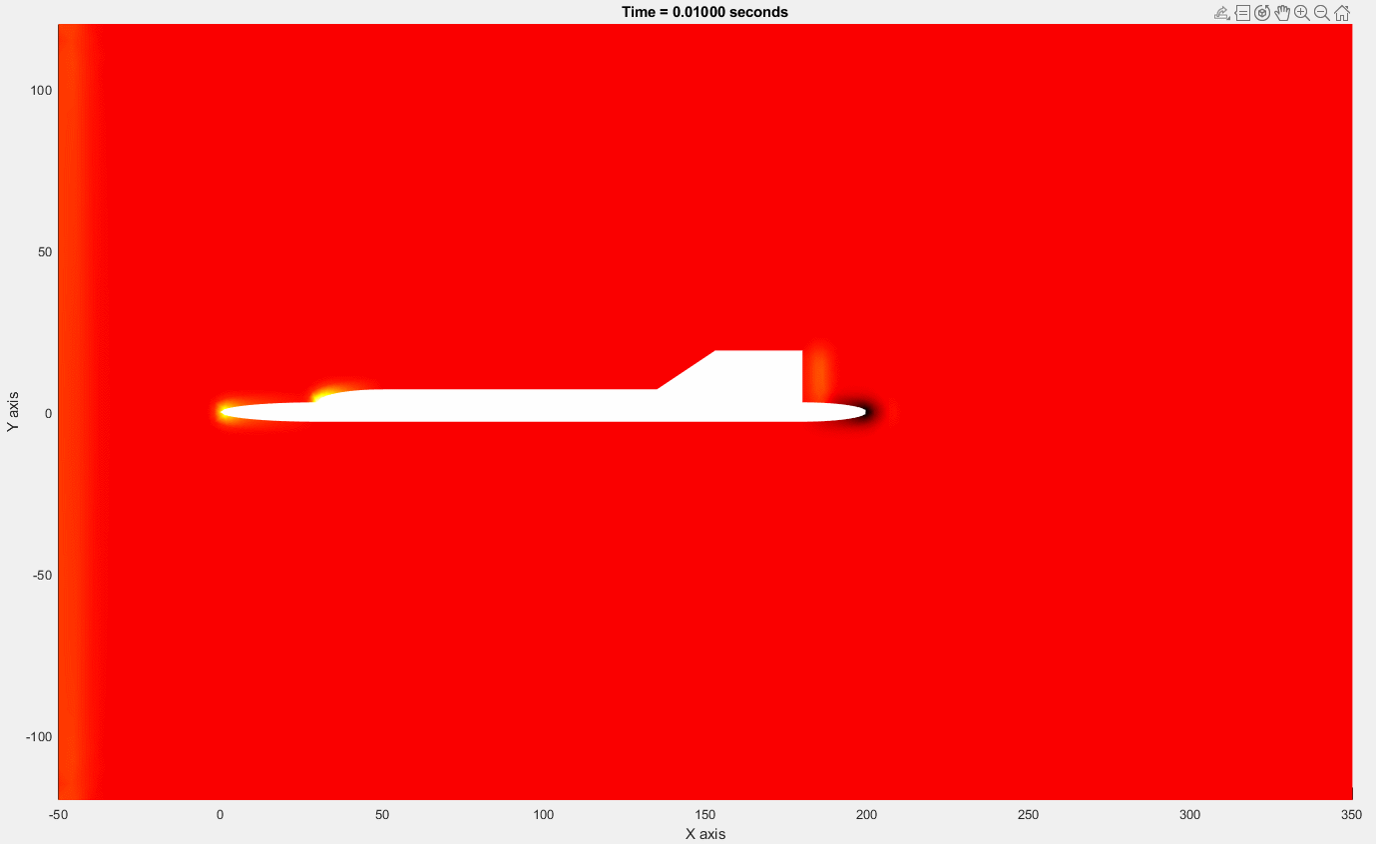

Slide 44
References
[1] Flux vector splitting scheme - TIFR centre for applicable ... Flux Vector Splitting Schemes. (n.d.). Retrieved April 22, 2022, from http://math.tifrbng.res.in/~praveen/notes/acfd2013/fvs.pdf
[2] Finite volume method on unstructured grids. (n.d.). Retrieved April 22, 2022, from http://math.tifrbng.res.in/~praveen/notes/acfd2013/fvm.pdf
[3] Anderson, J. D. (1982). Modern compressible flow. McGraw-Hill.
[4] A positivity preserving ﬁnite element–ﬁnite volume solver ... (n.d.). Retrieved April 22, 2022, from https://people.math.carleton.ca/~elorin/paper_spalart.pdf
[5] Gueyffier, D., Onera, Roux, F. X., Fabignon, Y., Chaineray, G., Lupoglazoff, N., Vuillot, F., Hijlkema, J., Alauzet, F., Institut National de Recherche en Informatique et en Automatique Paris-Rocquencourt, M., B., H., R., L., K. A. and G., A, K., A., W. M., D., D. F. and R., R., A. S. and A., S., S. J., E., C., … J., D. (2015, August 11). Accurate computation of grain burning coupled with flow simulation in Rocket Chamber. Journal of Propulsion and Power. Retrieved April 22, 2022, from https://arc.aiaa.org/doi/10.2514/1.B35736
[6] Chang, C.-L. (2006). Time-accurate, unstructured-mesh Navier-Stokes ... Retrieved April 22, 2022, from https://ntrs.nasa.gov/api/citations/20060027797/downloads/20060027797.pdf?attachment=true
[7] Hirsch, C. (2007). Numerical computation of internal and external flows (2nd ed.). Elsevier/Butterworth-Heinemann.

